Slide 1



Predicting Concrete Compressive Strength
By Rakshit Mahajan

Slide 2

Learning Objectives
To predict concrete compressive strength using machine learning and CNN models.
To promote sustainability by optimizing material use in construction.
To perform data preprocessing and visualization for better understanding of key features.
To train, test, and evaluate models for accurate strength prediction.
To develop an interactive Streamlit web app for real-time predictions.
To gain practical experience in AI, deep learning, and data analytics tools.
GOAL
Source :
www.freepik.com/

Slide 3
Tool’s and Technology used:
Programming Language: Python
Libraries: Pandas, NumPy, Scikit-learn, TensorFlow, Keras, Matplotlib, Seaborn
Web Framework: Streamlit (for deployment)
Dataset Source: UCI Machine Learning Repository
Version Control: GitHub
IDE / Platform: Google Colab

Slide 4
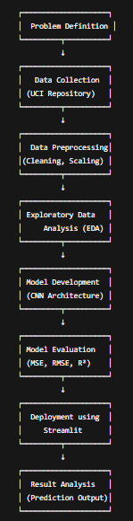
Methodology
Problem Identification
---Defined the objective: Predict concrete compressive strength using ML & CNN.
Data Collection
---Downloaded dataset from UCI Machine Learning Repository.
Data Preprocessing
---Cleaned and normalized data for accurate model training.
Exploratory Data Analysis (EDA)
---Used Matplotlib and Seaborn for correlation and feature analysis.
Model Development
---Built and trained a Convolutional Neural Network (CNN) model using TensorFlow/Keras.
Model Evaluation
---Assessed performance using MSE, RMSE, and R² score.
Deployment
---Created an interactive Streamlit web app for real-time predictions.
Result Interpretation
---Compared actual vs predicted results and visualized model accuracy.

Slide 5
Problem Statement:
Concrete is one of the most widely used construction materials, and its compressive strength is a key factor determining structural performance and safety.
However, testing concrete strength through laboratory experiments is time-consuming, costly, and requires specialized equipment.
To address this, the project aims to develop a predictive model that can accurately estimate the compressive strength of concrete based on its ingredients (cement, water, coarse and fine aggregates, fly ash, superplasticizer, and age) using machine learning techniques.
This approach helps in:
Reducing the need for repetitive laboratory tests,
Saving time and resources, and
Improving quality control during construction.

Slide 6
Solution:
We propose a data-driven solution that predicts concrete compressive strength from mix components and curing age using a Convolutional Neural Network (CNN) with uncertainty estimation and a user-friendly deployment:
Data preparation
  Use the UCI Concrete dataset (CSV), clean data, handle missing values, and scale features (MinMax / StandardScaler).
Feature engineering & EDA
  Analyze correlations, distributions, and select/engineer features (e.g., water/cement ratio) that impact strength.
Modeling
  Train a 1D-CNN regression model on the tabular inputs (treat features as a 1-D sequence).
  Add Dropout and use Monte Carlo Dropout at inference to estimate prediction uncertainty.
  Compare with baseline models (Linear Regression, Random Forest) and pick best-performing model.
Evaluation
  Measure performance using MAE, RMSE, and R²; visualize Actual vs Predicted and uncertainty bands.

Slide 7
Optimization
  Tune hyperparameters (filters, dropout, learning rate) using KerasTuner or RandomSearch.
Explainability
  Use SHAP or permutation importance to show which ingredients most influence strength (helpful for engineers).
Sustainability insight
  Estimate CO₂ from cement content and compute a simple sustainability score (strength / CO₂ tradeoff).
  Suggest low-carbon mix alternatives (e.g., increase fly ash/slags) when possible.
Deployment
  Package the model into a Streamlit web app (runs in Colab or Streamlit Cloud) with sliders for mix inputs, live prediction, uncertainty display, and sustainability tips.
Deliverables
  Notebook (EDA → model → evaluation), trained model file (.keras), Streamlit app code, short PDF summary for submission.

Slide 8
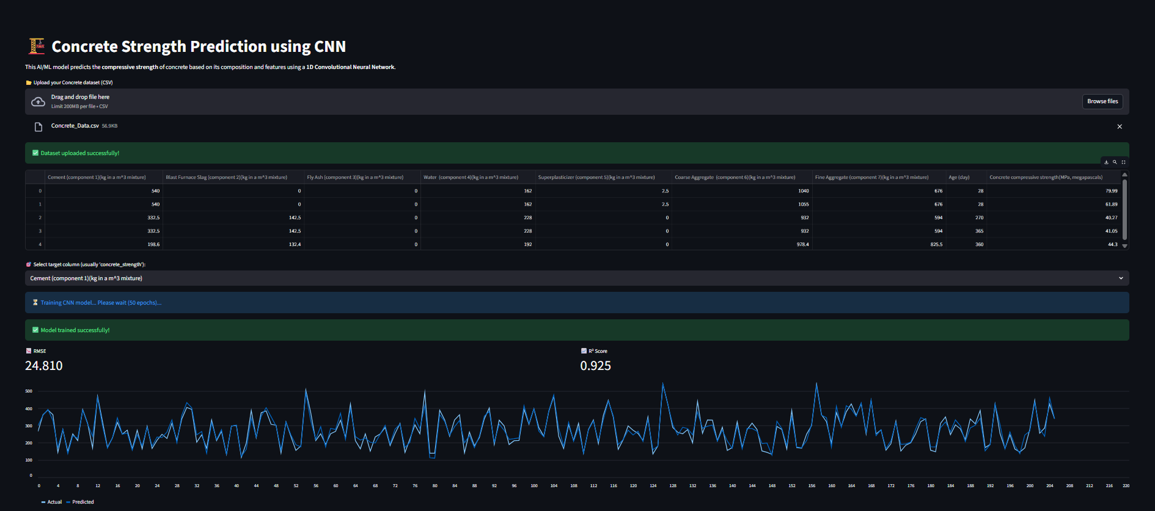
Screenshot of Output:

Slide 9


Slide 10
Conclusion:
CNN model accurately predicts concrete compressive strength.
Reduces manual testing time and cost.
Key factors: cement, water, and curing age.
Enhances mix design through AI-based insights and sustainability focus.
Demonstrates the value of ML in modern civil engineering applications.
Overall, this project highlights the potential of AI-driven tools in civil engineering to enhance efficiency, accuracy, and sustainability in material design and quality assessment.

